Slide 1
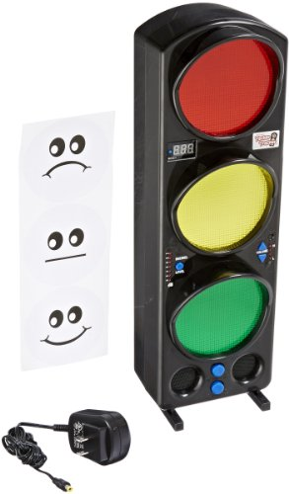
Requirements from Team 45
Must continuously measure the level of sound in surroundings
Must set values for warning (almost excessive) and excessive amounts of sound
Must clearly indicate which level the sound is currently on
When sound changes levels, must indicate the change
Basically, make a prototype for a better “teacher’s sound stoplight”
http://ecx.images-amazon.com/images/I/414HLsroXDL.jpg

